Slide 1
Shocker Track Club
Elite Team 2018 - 2019

Slide 2
SHOCKER TRACK CLUB
Mission
The Shocker Track Club, Inc., (STC) is a 501(C)(3) organization that supports Wichita State University Track and Field and Cross Country and area Track and Field activities by supporting Elite, Open, Masters, Road Racing, and Youth Athletics Teams

Slide 3
Shocker Track Club
USA Track & Field Certified Club
Missouri Valley Association Club No. 28-4080

Slide 4
History of the Elite Team
Shocker Track Club has had Elite Team members since 2011.
The first members were John Hetzendorf (Javelin), Chandra Andrews, (Hammer), Darius Draudvila (Decathlon for Lithuania), Fernanda Blakely (Sprints), and Trent Mazanec (Javelin).
Elite Team members competed in the Olympic Trials in 2012 and 2016, and at least one athlete has competed in the USATF National Championship meets (either Indoor or Outdoor) since 2012.

Slide 5
How Does an Athlete Become an Elite Team Member
The Elite Team is comprised of "high achieving" athletes with "better than good" marks in their events.
Some have been NCAA All-Americans, others have been been conference champions. All have been very good athletes that have reasonably high aspirations and desire to be serious about their training. Many are former Shockers.
Starting in 2017, STC began requiring all Elite Team members to:
(1) Be approved for membership consideration via an application process
(2) Be a Member of USATF, and
(3) Successfully complete the USATF background check.
Members must also sign an Agreement with the Shocker Track Club.

Slide 6
What is Provided to Elite Team Members
A full uniform (i.e., Jersey, t-shirt, full warm-up suit,
Other accessories (e.g., water bottle, ball caps, etc.)
Support in registering for track meets
Support in seeking sponsorships, and sometimes limited financial support for travel.
Access to practice facilities at Wichita State's Cessna Stadium and Heskett Center
Coaching strategies and workouts.

Slide 7
Who Are the Current Elite Team Members?
Skyler Arneson
Throws and Highland Games
Dominic Artis
Sprints
Tyler Knight
Pole Vault
Chris Peters
Multi-Events
Airick Johnson
Hurdles
Jaimie Bookout
Pole Vault
Brittany Kallenberger
Pole Vault
Tonya Nero
Distance
Gavyn Yetter
Multi-Events
Chelsea Baker
High Jump

Slide 8
Who Are the Potential Elite Team Members?
Austin Bahner
Multis
Joshua Manuel
Sprints
Isaac Clark
Middle Distance
Jacob Clark
Middle Distance
Katie Murray
High Jump
Meghan Slim Holmes
Horizontal Jumps
Nikki Larch-Miller
Multis
Gage Garcia
Distance
Aaron Babbidge
Sprints

Slide 9
What Leadership is currently in place
John Wise (the Wichita State Assistant Director of Track and Field and Cross Country) currently serves as the Director of the program. Contact John at jwise@goshockers.com
John “JK” Kornelson (the former Head Coach of Wichita State University Track and Field and Cross Country) serves as the Head Coach. Contact Coach Kornelson at elitecoach@shockertrackclub.com
Tyler Knight, a member of the Elite Team serves in a very strong support role and as a liaison with the other Elite team members. Contact Tyler at eliteliaison@shockertrackclub.com

Slide 10
What Does the Director of the Elite Team Do?
The Director is the operational ”head" of the Elite Team. The "position" would also be a member of the Board of Directors of the Shocker Track Club. At a minimum, the Director would:
Direct the program
Work closely with the Assistant Director of Track and Field for Wichita State University
Work closely with other members of the Board,
Develop ideas for fundraising and sponsorships
Coordinate participation for the athletes in various meets
Communicate regularly with the “Athlete Congress" comprised of the team athletes.

Slide 11
What Does the Head Coach Do
Assist Athletes with developing practice and training strategies as needed
Serve as the Lead Coach in the event of Assistant Coaches
Identify coaches for athletes as needed
Attend meets when available

Slide 12
Elite Team Organization
Director
Admin Support
Head Coach
Athlete Liaison
Assistant Coaches
Athlete Congress

Slide 13
Elite Team Organization
Director
John Wise
Board Support
Darren Muci
Head Coach
JK Kornelson
Athlete Liaison
Tyler Knight
Assistant Coaches
Athlete Congress
Team Members

Slide 14
Questions
?
?
?
?

Slide 15
Shocker Track Club
General Overview

Slide 16
History
Wichita State University Track and Field Director, Steve Rainbolt, and Assistant Head Track Coach, John Wise developed the Shocker Track Club concept in 2010. Longtime Wichita State and USATF official Darren Muci was approached about leading an initiative to form a track club that would:
(1) Provide USATF meet planning, and certified officials and volunteers, for Wichita State University Track & Field and Cross Country meets,
(2) Help raise funds to support local track and field initiatives, and,
(3) Help develop and support Elite, Masters, Open, and Youth track teams.

Slide 17
What STC Does …
Provide Certified USATF Officials and Meet Volunteers for Wichita State Track and Field meets
Promote and Fundraise for Wichita State Track & Field
Support –
Elite Team
Open Team
Road Racing Team
Masters Team
Youth Team
Plan and Facilitate 3-5 annual Track & Field meets
Facilitate an Athlete Recruiting Combine

Slide 18
STC Organizational Structure
Board of Directors
Executive Committee
Elite Team
Masters Team
Youth Team
Officials
Finance
Membership
Communications
Fundraising
Open Team
Volunteers
Road Racing Team
Founded in 2011
501(C)(3) in 2013
Supports WSU Track & Field
Officials & Volunteers
Athletics Teams
Elite
Masters
Open
Youth
Road Racing

Slide 19
STC Board of Directors
Board Officers & Chairs
Board Members
Darren Muci, President
Chris Ellis, Vice President
Larry Staton, Secretary
Chad Green, Treasurer
Steve Rainbolt, WSU Head Coach
John Wise, WSU Asst Head Coach and Elite Team Director
Larry Staton, Masters Team
Dylan Hartnett, Open Team
Stephanie Knab Aranda, Youth Team
Curt Rierson, Road Racing Team
Emily Green Maier, Road Racing Team
Rob Garcia, Officials
Anita Curtis Cole Davis Vic Everett Ron Ewy Denis Fraizer Curtis Hernandez Amber Hetzendorf Mike Holladay Joe Hoover Tyler Knight J Means Mark Schwarm
Ex Officio Members – Chandra Andrews Bill Faflick Patric Jackson Gilda Muci Ryan Patton Shamoya Pruitt

Slide 20
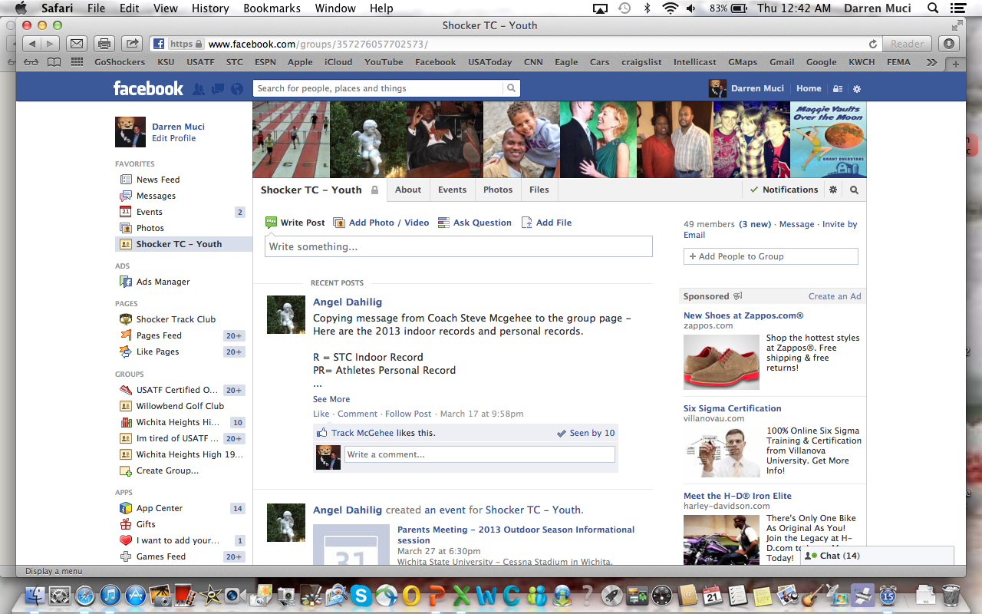
Follow STC …
www.shockertrackclub.com
Facebook – Shocker Track Club Elite Team
Twitter - @ShockerTC

