Slide 1
SHOCKER TRACK CLUB ShockerTrackClub.com

Slide 2
SHOCKER TRACK CLUB
Mission
The Shocker Track Club, Inc., (STC) is a 501(C)(3) organization that helps support Wichita area Track and Field and Cross Country activities.

Slide 3
History
Wichita State University Track and Field Director, Steve Rainbolt, and Assistant Head Track Coach, John Wise developed the Shocker Track Club concept in 2010. Longtime USATF official Darren Muci was approached about leading an initiative to form a track club that would:
(1) Provide USATF meet planning, and certified officials and volunteers, for Wichita State University Track & Field and Cross Country meets,
(2) Help raise funds to support local track and field initiatives, and,
(3) Help develop and support Elite, Masters/Open, and Youth track teams.

Slide 4
STC Organizational Structure
Board of Directors
Executive Committee
Elite Team
Masters/Open Team
Youth Team
Officials/Volunteers
Finance
Membership
Communications
Fund Raising
Founded in 2011
501(C)(3) in 2013
Supports WSU Track & Field
Officials & Volunteers
Athletics Teams
Elite
Masters/Open
Youth

Slide 5
STC Board of Directors
Officers & Chairs
Members
Darren Muci, President
Chris Ellis, Vice President
Chandra Andrews, Treasurer
Larry Staton, Secretary
Steve Rainbolt, WSU Head Coach
John Wise, WSU Asst Head Coach
Sarah Doyle, Membership
Laura Markuly, Fundraising
VACANT, Communications
VACANT, Officials/Volunteers
Dylan Hartnett, Elite Team
Patrick Simon, Youth Team
Larry Staton, Masters/Open
Michael Draut
Vic Everett
Bill Faflick
Brian Hargrove
Mike Holladay
Amber McGown
Emily Green Maier
Jerry Proffitt
Darius Draudvila, Ex Officio
TJ Arant, Ex Officio
Joan Hearne, Ex Officio

Slide 6
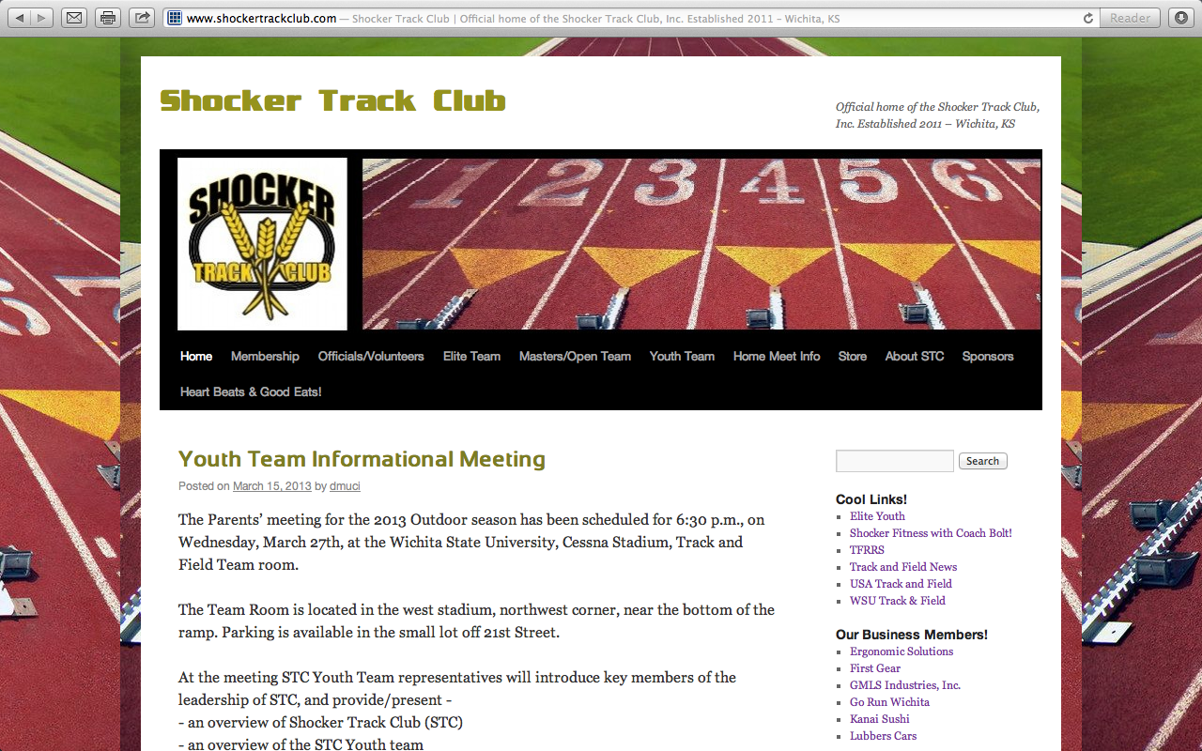
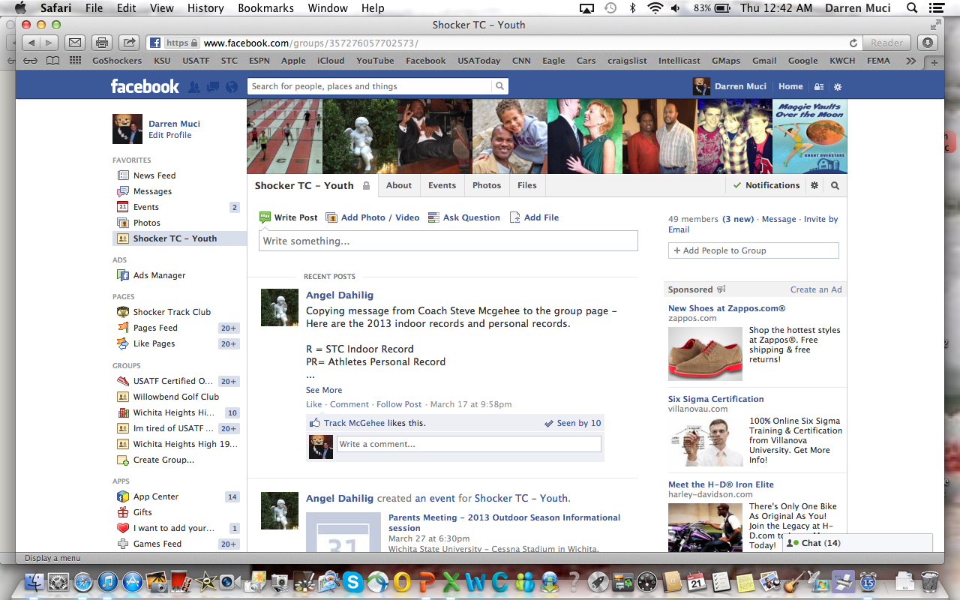
Follow STC …
www.shockertrackclub.com
Facebook – Shocker Track Club
Twitter - @ShockerTC
Facebook – Youth Team
Twitter - @YouthShockerTC

Slide 7
Questions
?
?
?
?

Slide 8
Shocker Track Club
Youth Team – Winter Indoor 2013 - 2014

Slide 9
2013 – 2014 Changes
“Shocker Track Club Way”
Refined Mission and Vision
New Leadership Team Structure
Team workouts and practices designed by the coaching staff of Wichita State University Track and Field
Published workouts with progress tracking

Slide 10
Why Change?
Improve the STC Youth “product”
Strengthen connection to WSU Track & Field
Establish consistent coaching methodology
Provide mechanism for strategic growth and improvement for youth athletes

Slide 11
Leadership Structure
STC Board of Directors
Youth Director
WSU Liaison
Team Mom
Coaches
Asst Team Mom(s)

Slide 12
Youth Team – Mission
Provide opportunities for youth to compete in track and field from an introductory level, to high-level competition, under the framework of USATF guidelines.
Experienced and certified coaches provide appropriate guidance and leadership. Separate indoor and outdoor seasons provide opportunities for nearly six months of training.

Slide 13
Coaching Philosophy
Oversight, Coaching, and Support
is performed in a way that:
provides opportunities for participating youth to have fun,
provides opportunities for youth to improve as track and field athletes, and
teaches youth to set goals and develop character through sportsmanship,
So that

Slide 14
Coaching Philosophy
youth participants develop a life-long love of the sport,
the club develops the best youth athletes in the community, and
youth participants develop to their fullest potential, and grow to become responsible athletes and citizens.

Slide 15
Coaches and Volunteers
All STC Youth Coaches AND Volunteers MUST:
Be USATF members
$30 annual membership
Have passed a USA Track & Field background check
This includes parents/guardians that want to assist their own children during official practices.
$8 fee

Slide 16
Youth Team Leadership
Patrick Simon Director
Curtis Hernandez Asst Director
John Wise WSU Liaison

Slide 17
Youth Team Coaches
Kerisha Broadus Multis
Denis Fraizer Pole Vault
Samuel Glomstad-Foster Sprints
Scott Parker Jumps
Shamoya Pruitt Sprints
Noel Singh Sprints
John Thompson II Sprints

Slide 18
Parents/Guardians
Parents are important to the success of the athlete and the track club.
Please observe the following:
Maintain a positive attitude
Pay all fees in a timely manner
Realize that once an athlete is at a given facility, they are under the supervision/jurisdiction/guidelines of the STC Youth Team management and coaching staff
Ensure that the athlete is at practice and at meets on time
Remain in the seating area at practice and meets
Ask questions of STC Youth management and coaches at an appropriate time and in an appropriate manner

Slide 19
Youth Practices
WSU Cessna Stadium
April 15 through May 29
Tuesday and Thursday
430p to 600p
June 2 through July 23
645p to 815p
Alternate locations with notice -
Wichita State’s Cessna Stadium
Plainview Park

Slide 20
STC Home Youth Outdoor Meets
WSU Cessna Stadium
June 2014 - TBD
All USATF Sanctioned and F.A.T.

Slide 21
Youth Meets
See handout

Slide 22
Shocker Track Club
Youth Programs – Spring Summer 2013 - 2014

Slide 23
Developmental
Ages 6-16 – ($100 per season)
Group focuses on basic training and instruction of the three disciplines within track and field (running, jumping, throwing) on basic training and fitness, not competition.
Fee includes:
USATF membership
Coaching
Team T-shirt
Practice time at WSU Cessna Stadium
Thursday Night WSU Track Meets

Slide 24
Competition
Ages 8-18 – ($210 per season)
Group focuses on taking competitive skills to the next level – going from good to great, from great to excellent, from excellent to superior! Group will participate in meets focusing on state and regional competition within USA Track & Field.
Fee includes:
USATF membership
Coaching
Team Uniform (singlet, shorts, t-shirt, warm-up suit)
Practice time at WSU Cessna Stadium
Thursday Night WSU Track Meets
Meet day hydration and snacks

Slide 25
Elite
Ages 14-19 – ($310 per season)
Group focuses on developing a particular skill set of advanced athletes with the plan on qualifying for a national team on the youth and/or junior national level.
Fee includes:
USATF membership
Personal Coaching
Team Uniform (singlet, shorts, t-shirt, warm-up suit)
Practice time at WSU Cessna Stadium
Thursday Night WSU Track Meets
Meet day hydration and snacks
Registration fees to national meets

Slide 26
Shocker Track Club
USA Track & Field Affiliation
Missouri Valley Association
Club No. 28-4080

Slide 27
USATF Youth Membership
STC purchases memberships using personal information for each youth athlete.
This includes address, phone number(s), email address, and parent/guardian contact.
To verify an athlete’s date-of-birth, parents will forward a scanned copy of the athlete’s birth certificate to membership@usatf.org.
USA Track & Field will contact youth members directly to provide important membership information.
USA Track & Field must be able to get in touch directly with the household/parents of our youth athletes.

Slide 28
USATF Membership Benefits
10% discount in the USATF Online Store
Subscription to Fast Forward magazine
Exclusive members only news items
Exclusive members-only contests
Sports accident insurance
Special shopping discounts and offers
Discount tickets to USATF events

Slide 29
Questions
?
?
?
?

