Slide 1
Shocker Track Club
Youth Outdoor 2018

Slide 2
SHOCKER TRACK CLUB
Mission
The Shocker Track Club, Inc., (STC) is a 501(C)(3) organization that helps support Wichita area Track and Field and Cross Country activities.

Slide 3
Youth Team – Overview
Coaching in every event in Track & Field
Coaching for Ages 5 through 19
Practices at Wichita State University’s Cessna Stadium or on campus
Nearly all Coaches have NCAA Division 1, 2, and NAIA Competition experience
Coaching strategies based upon Wichita State University and Friends University philosophies
Strong connections to Wichita State University and Friends University Track and Field Coach staffs

Slide 4
Youth Team – Mission
Provide opportunities for youth to compete in track and field from an introductory level, to high-level competition, under the framework of USATF guidelines.

Slide 5
Outdoor Team Leadership
Stephanie Knab, Youth Team Director
youth@shockertrackclub.com
315-751-6033
Gilda Muci, Youth Team Operations
youthoperations@shockertrackclub.com
316-990-6824
Anita Curtis, Youth Team Mom
Teammom@shockertrackclub.com
620-253-2858

Slide 6
Registration Fee Structure
April | May | June | July
Costs and Amenities
$200 | $180 | $160 | $140
43 practices | 35 practices | 25 practices | 13 practices
Tuesday & Thursday evenings & Saturday afternoons | Tuesday and Thursday evenings | Monday, Tuesday and Wednesday evenings | Monday, Tuesday and Wednesday evenings
T-Shirt, Jersey & Wristband | T-Shirt, Jersey & Wristband | T-Shirt, Jersey & Wristband | T-Shirt, Jersey & Wristband
Sunglasses, Towel and Water Bottle | Towel and Water Bottle | Water Bottle
Thursday Summer Series Meets in June/July | Thursday Summer Series Meets in June/July | Thursday Summer Series Meets in June/July | Thursday Summer Series Meets in June/July

Slide 7
Outdoor Team Practices
April Practices – 8 total
600p to 730p on Tuesdays and Thursdays, and Saturdays from 100p to 230p
Dates - April 5, 7, 17, 19, 21, 24, 26 and 28
May Practices – 10 total
600p to 730p on Tuesdays and Thursdays
Dates - May 1, 3, 8, 10, 15, 17, 22, 24, 29 and 31
June Practices – 12 total
645p to 815p on Mondays, Tuesdays and Wednesdays
Dates - June 4, 5, 6, 11, 12, 13, 18, 19, 20, 25, 26 and 27
July Practices – 13 total
645p to 815p on Mondays, Tuesdays and Wednesdays
Dates - July 2, 3, 9, 10, 11, 16, 17, 18, 23, 24, 25, 30 and 31

Slide 8
Youth Track & Field Meets
USATF SANCTIONED SCHEDULED MEETS -
Grandview Invitational – June 2, 2018 (Grandview High School, Grandview, MO)
Olathe Invitational – June 9, 2018 (Olathe North High School, Olathe, KS)
Missouri Valley Association Championship – June 16, 2018 (William Jewel College, Liberty, MO)
USATF Region 9 Championship – July 5 - 8, 2018 (Little Rock, AR)
July 23-29, 2018 – USATF Hershey National Junior Olympic Track and Field Championships North Carolina A&T University, Greensboro, NC
OPEN COMPETITION SCHEDULED MEETS –
July 13-14, 2018 - Sunflower State Games, Topeka, KS

Slide 9
Leaders and Coaches
All STC Youth Leadership/Coaches MUST:
Have applied to Shocker Track Club
Be a USATF member
Have passed a USA Track & Field background check
Have completed USOC SafeSport Training
The above applies to parents/guardians that want to assist their own children during official practices.

Slide 10
STC Outdoor Team Head Coaches
Sprints Natali Engle
Distance Curtis Hernandez
Pole Vault Tyler Knight
Multi-Events Gavyn Yetter
Horizontal Jumps Meghan Holmes
Throws Matt Byers
High Jump Chelsea Baker
Hurdles Gavyn Yetter

Slide 11
STC Outdoor Assistant Coaches
Sprints –
Erin Hart, Marqus Wilson
Horizontal Jumps –
Marqus Wilson, Isaac Smallwood
Multi-Events -
Chelsea Baker
Throws –
Craig Curtis, Krisha Parmar
Pole Vault –
Andrew Brown, Jaimie Bookout, Hannah Buller
Fitness –
Alex Muci, Krisha Parmar
Distance –
Jason Parr, Kyle Martens

Slide 12
Coaching Philosophy
Oversight, Coaching, and Support is performed in a way that:
Provides opportunities for youth to improve as track and field athletes,
Provides opportunities for participating youth to be serious and have fun, and
Teaches youth to set goals and develop character through sportsmanship.

Slide 13
Practice Philosophy
Practices are planned, organized and facilitated to:
Be safe
Promote fitness
Understand the importance of good nutrition
Develop skills and knowledge of Track and Field
Challenge athletes to work hard
Teach goal setting
Have fun!

Slide 14
Parents/Guardians
Parents are important to the success of the athlete and the Shocker Track Club.
Please observe the following:
Maintain a positive attitude
Remain in the seating area at practice and meets
Ensure that the athlete is at practice and at meets on time
Pay all fees in a timely manner
Realize that once an athlete is at a given facility, they are under the supervision/jurisdiction/guidelines of the STC Youth Team management and coaching staff
Ask questions of STC Youth Team management and coaches at an appropriate time and manner

Slide 15
Sportsmanship
Shocker Track Club is about development of character, respect, friendships and teamwork.
Expectations of Athletes are:
Support teammates at all times.
Exhibit positive behavior at all times.
Avoid mistreating or making fun of teammates.
Be attentive and not disruptive.

Slide 16
Success Stories
STC Youth has qualified at least two (2) athletes to compete at either the USATF or AAU Junior Olympics since 2013.
In 2016, the Kansas High School 4A, 5A, and 6A Girls Pole Vault Champions, and and 4A and 6A Boys Champion, were STC Youth Team Members
In 2017, the Kansas High School 5A and 6A Girls Pole Vault Champions, 6A Boys Champion, and 6A Girls 200m and 400m Champion were STC Youth Team Members
Eleven (11) athletes qualified to compete at the 2017 USATF Junior Olympics

Slide 17
To The Future….
Former athletes in the STC Youth Program have earned scholarships to compete at:
Wichita State University
Kansas State University
Washburn University
Friends University
Missouri Southern University
Missouri S & T University
Colorado School of the Mines

Slide 18
Communication Methods
Pre- or Post-Practice discussions
Periodic News letters sent via email
Website - www.shockertrackclub.com
Facebook Pages
Twitter - @STCYouthTeam

Slide 19
USATF Youth Membership
Shocker Track Club is a Certified USATF Club
We STRONGLY recommend that Youth athletes purchase an annual USATF membership - $20
Parents/Guardians MUST purchase a USATF membership for their child if they wish for their child to participate in USATF championship-track meets
www.usatf.org
Club no. 28-4080

Slide 20
USATF Membership Benefits
10% discount in the USATF Online Store
Subscription to Fast Forward magazine
Exclusive members only news items
Exclusive members-only contests
Sports accident insurance - Secondary coverage
Special shopping discounts and offers
Discount tickets to USATF events

Slide 21
Questions
?
?
?
?

Slide 22
Shocker Track Club
USA Track & Field Affiliation
Missouri Valley Association
Club No. 28-4080

Slide 23
History
Wichita State University Track and Field Director, Steve Rainbolt, and Assistant Head Track Coach, John Wise developed the Shocker Track Club concept in 2010. Longtime Wichita State and USATF official Darren Muci was approached about leading an initiative to form a track club that would:
(1) Provide USATF meet planning, and certified officials and volunteers, for Wichita State University Track & Field and Cross Country meets,
(2) Help raise funds to support local track and field initiatives, and,
(3) Help develop and support Elite, Masters, Open, and Youth track teams.

Slide 24
What STC Does …
Provide Certified USATF Officials and Meet Volunteers for Wichita State Track and Field meets
Promote and Fundraise for Wichita State Track &Field
Support –
Elite Team
Open Team
Road Racing Team
Masters Team
Youth Team
Plan and Facilitate 3-5 annual Track & Field meets
Facilitate an Athlete Recruiting Combine

Slide 25
STC Organizational Structure
Board of Directors
Executive Committee
Elite Team
Masters Team
Youth Team
Officials
Finance
Membership
Communications
Fundraising
Open Team
Volunteers
Road Racing Team
Founded in 2011
501(C)(3) in 2013
Supports WSU Track & Field
Officials & Volunteers
Athletics Teams
Elite
Masters
Open
Youth
Road Racing

Slide 26
STC Board of Directors
Board Officers & Chairs
Board Members
Darren Muci, President
Chris Ellis, Vice President
Larry Staton, Secretary
Chad Green, Treasurer
Steve Rainbolt, WSU Head Coach
John Wise, WSU Asst Head Coach and Elite Team Director
Larry Staton, Masters Team
Dylan Hartnett, Open Team
Stephanie Knab, Youth Team
Curt Rierson, Road Racing Team
Emily Green Maier, Road Racing Team
Rob Garcia, Officials
Anita Curtis
Cole Davis
Vic Everett
Ron Ewy
Denis Fraizer
Curtis Hernandez
Amber Hetzendorf
Mike Holladay
J Means
Mark Schwarm
Ex Officio Members -
Chandra Andrews
Bill Faflick
Patric Jackson
Gilda Muci
Ryan Patton
Shamoya Pruitt

Slide 27
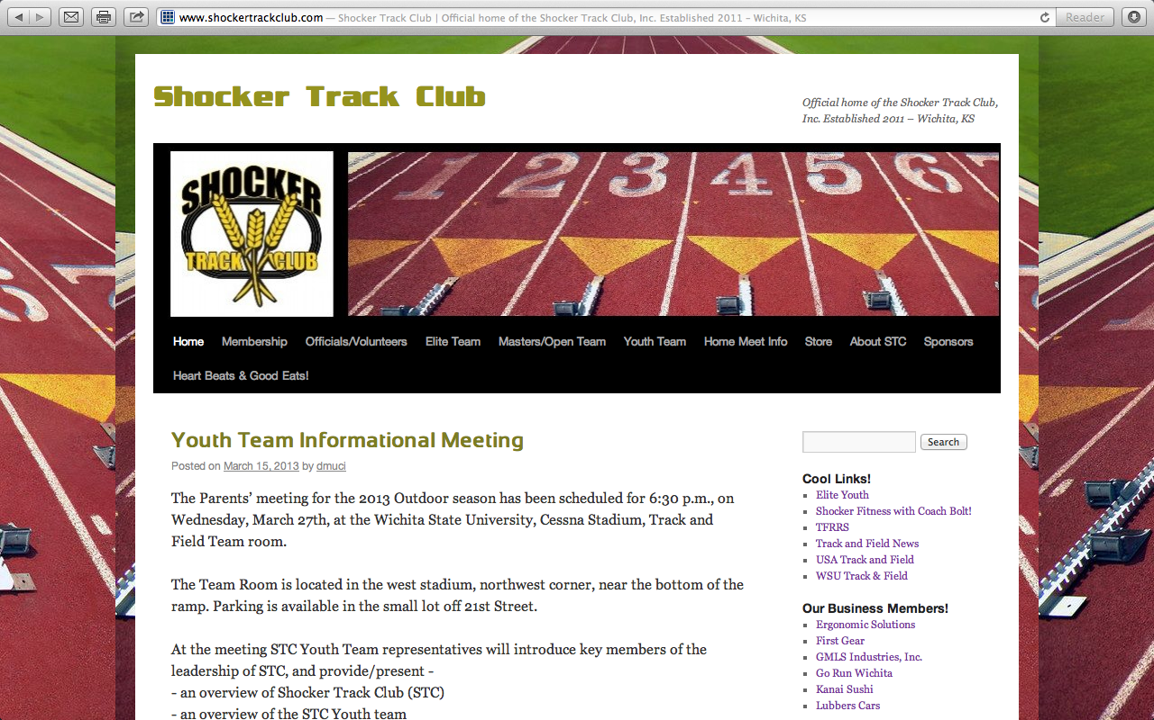
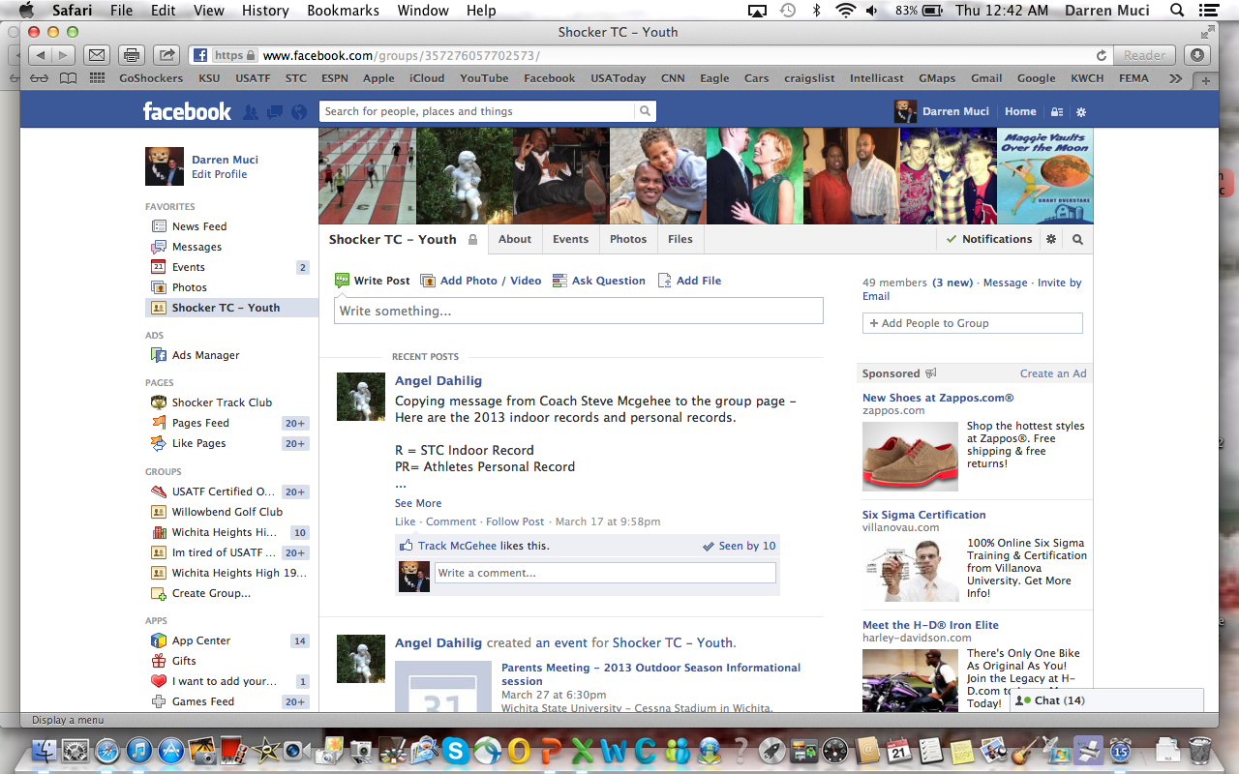
Follow STC …
www.shockertrackclub.com
Facebook – Shocker Track Club
Twitter - @ShockerTC
Facebook – Youth Team
Twitter - @STCYouthTeam
Twitter - @STCRoadRacing

Slide 28
Questions
?
?
?
?

