Slide 1
Shocker Track Club
Pole Vault Training – Indoor 2017 - 2018

Slide 2
Youth Team – Mission
Provide opportunities for youth to compete in track and field from an introductory level, to high-level competition, under the framework of USATF guidelines.

Slide 3
Indoor Pole Vault Team Leadership
Denis Fraizer, Head Pole Vault Coach
polevault@shockertrackclub.com
316-680-0852
Darren Muci, Team Dad
president@shockertrackclub.com
316-993-6824
Gilda Muci, Youth Team Operations
youthoperations@shockertrackclub.ccom
316-990-6824

Slide 4
Fee Structure
Join in November $160
Join in December $140
Join in January $120
Join in February $100*
Fee includes:
Coaching/Practice Time at NE Magnet High School
35 practices
Team Shirt and Towel *
Participation in STC Butterworth Indoor Meet*
January 27, 2018 – WSU Heskett Center
Swimming Pool Training – once monthly

Slide 5
Pole Vault Practices
November 7 through February 24
Tuesdays and Thursdays
630p to 830p
Saturdays
100p to 300p

Slide 6
Leaders and Coaches
All STC Youth Leadership and Coaches MUST:
Have applied to Shocker Track Club
Be USATF members
Have passed a USA Track & Field background check
Have completed USOC SafeSport Training
The above applies to parents/guardians that want to assist their own children during official practices.

Slide 7
Pole Vault Team Coaches
Denis Fraizer Head Coach
Wichita State University
Andrew Brown Assistant Head
University of Nebraska, Kearney
Jaimie Bookout Assistant
University of Kansas
Tyler Knight Assistant
Wichita State University
Tina Clausen Assistant
Friends University

Slide 8
Coaching Philosophy
Oversight, Coaching, and Support
is performed in a way that:
provides opportunities for participating youth to have fun,
provides opportunities for youth to improve as track and field athletes, and
teaches youth to set goals and develop character through sportsmanship,

Slide 9
STC Youth PV Alumni
Athletes have earned scholarships and/or are competing at –
Wichita State University
Kansas State University
Friends University
Washburn University
Missouri Southern University
Missouri University of Science and Technology
Butler County Community College
Hutchinson Community College

Slide 10
Parents/Guardians
Parents are important to the success of the athlete and the Shocker Track Club.
Please observe the following:
Maintain a positive attitude
Realize that once an athlete is at a given facility, they are under the supervision/jurisdiction/guidelines of the STC Youth Team management and coaching staff
Remain in the seating area at practice and meets
Ask questions of STC Youth management and coaches at an appropriate time and in an appropriate manner
Ensure that the athlete is at practice and at meets on time
Pay all fees in a timely manner

Slide 11
Sportsmanship
Expectations of Athletes are as follows:
Shocker Track Club is about development of character, respect, friendships and teamwork. Athletes are expected to support teammates at all times.
Participation by the athletes is voluntary. We will teach and expect positive behavior at all times.
Mistreating or making fun of teammates will not be tolerated.
Athletes are expected to be attentive and not disruptive. ANY disruptive behavior will result in being dismissed from practice or may warrant dismissal from the team.

Slide 12
Questions
?
?
?
?

Slide 13
USATF Youth Membership
Shocker Track Club is a USATF Certified Club
We STRONGLY recommend that Youth and Open athletes purchase a USATF membership.
Parents/Guardians MUST purchase a USATF membership for their child if they wish for their child to participate in USATF championship-track meets
www.usatf.org
Club no. 28-4080

Slide 14
USATF Membership Benefits
10% discount in the USATF Online Store
Subscription to Fast Forward magazine
Exclusive members only news items
Exclusive members-only contests
Sports accident insurance
Secondary coverage
Special shopping discounts and offers
Discount tickets to USATF events

Slide 15
Questions
?
?
?
?

Slide 16
Shocker Track Club
Pole Vault – Indoor 2017 - 2018

Slide 17
SHOCKER TRACK CLUB
Mission
The Shocker Track Club, Inc., (STC) is a 501(C)(3) organization that helps support Wichita area Track and Field and Cross Country activities.

Slide 18
Shocker Track Club
USA Track & Field Affiliation
Missouri Valley Association
Club No. 28-4080

Slide 19
History
Wichita State University Track and Field Director, Steve Rainbolt, and Assistant Head Track Coach, John Wise developed the Shocker Track Club concept in 2010. Longtime USATF official Darren Muci was approached about leading an initiative to form a track club that would:
(1) Provide USATF meet planning, and certified officials and volunteers, for Wichita State University Track & Field and Cross Country meets,
(2) Help raise funds to support local track and field initiatives, and,
(3) Help develop and support Elite, Masters, Open, Youth, and Road Racing teams.

Slide 20
STC Organizational Structure
Board of Directors
Executive Committee
Elite Team
Masters Team
Youth Team
Officials
Finance
Membership
Communications
Fundraising
Open Team
Volunteers
Road Racing
Founded in 2011
501(C)(3) in 2013
Supports WSU Track & Field
Officials & Volunteers
Athletics Teams
Elite
Masters
Open
Youth
Road Racing

Slide 21
STC Board of Directors
Officers & Chairs
Members
Darren Muci, President
Chris Ellis, Vice President
VACANT, Treasurer
Larry Staton, Secretary
Steve Rainbolt, WSU Head Coach
John Wise, WSU Asst Head Coach and Elite Team Director
Larry Staton, Masters Team
Dylan Hartnett, Open Team
Stephanie Knab, Youth Team
Curt Rierson, Road Racing Team
Emily Green Maier, Road Racing Team
Anita Curtis
Cole Davis
Vic Everett
Ron Ewy
Denis Fraizer
Chad Green, Assistant Treasurer
Curtis Hernandez
Amber Hetzendorf
Mike Holladay
J Means
Mark Schwarm
Chandra Andrews
Bill Faflick
Patric Jackson
Gilda Muci
Ryan Patton
Shamoya Pruitt

Slide 22
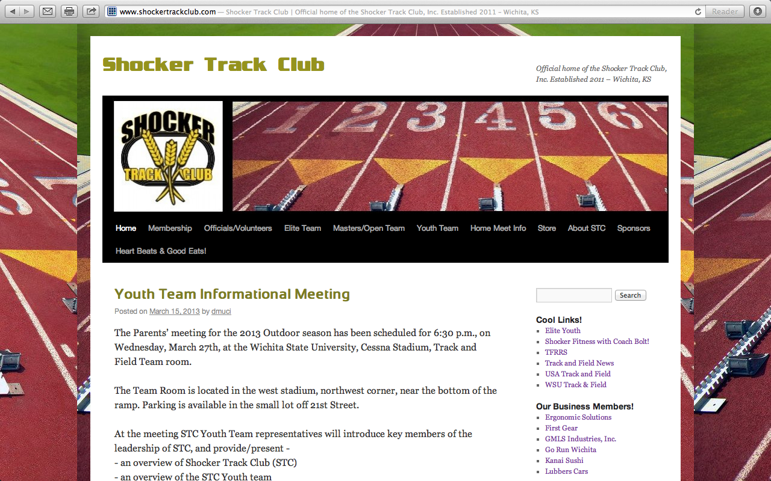
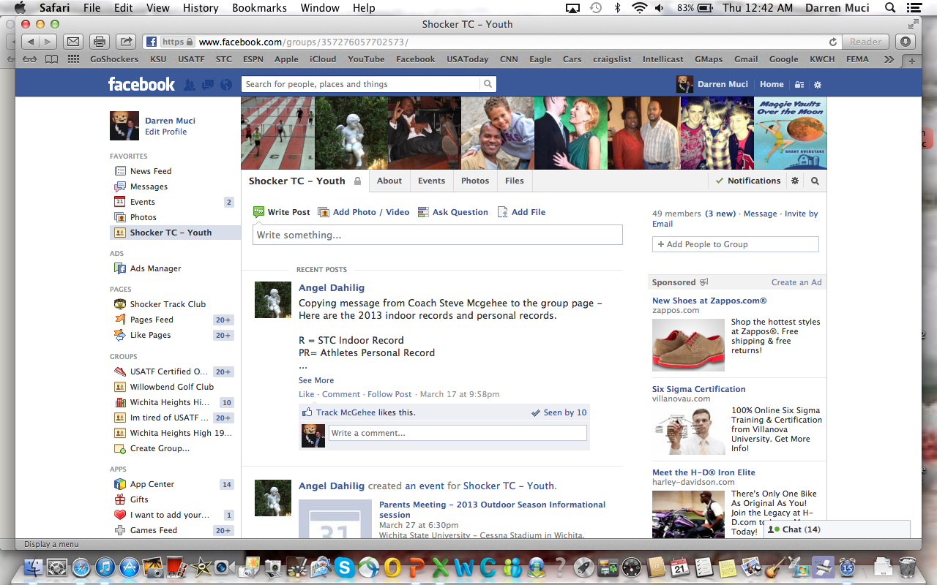
Follow STC …
www.shockertrackclub.com
Facebook – Shocker Track Club
Twitter - @ShockerTC
Twitter - @STCYouthTeam

Slide 23
Shocker Track Club
Pole Vault – Indoor 2017 - 2018

Slide 24
Questions
?
?
?
?

